Slide 1



NITK-CMU JOINT WINTER SCHOOL IPTSE TEXT BASED EMOTION RECOGNITION SYSTEM
TEAM MAP- PROJECT TEXEMO
DHRUV GOEL SKAND ARORA SATISH

Slide 2
VISION
We aim to make machines understand and detect emotions from any textual input.
CAUSE
About 70% of our data is in the form of texts. A lot of work has been done on analyzing speech and visuals which constitute just 30% of our information. In texts, machines have been successfully designed to recognize sentiments. However, no significant landmark has been achieved in recognizing emotions from text.

Slide 3
OBJECTIVE
“Given any textual input such as a word/phrase/sentence the machine should be able to give a percentage of various emotions that constitutes the input”

Slide 4
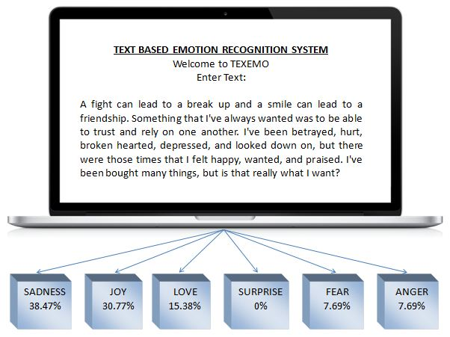

Slide 5
DATASETS
1500 words and 17000 phrases that were classified into different emotions
Google word2vec dataset consisting of 3 million words
217,000 phrases which were classified and 500,000 words which were not classified.

Slide 6
IMPEMENTATION
We consider 6 basic emotions: Joy, Surprise, Anger, Sadness, Fear, Love/Disgust.
The user input can be a word/sentence/paragraph.
The implementation is centered around the concept of representing every words in the form of vectors.
We had 5 different approaches to achieve our objective.

Slide 7
APPROACH 1
Feed our dataset of 1500 words to word2vec tool and obtain the vector representation of all the words.
Given an input sentence find out cosine distance between the vectors in the dataset and the input word vector.
Constraint: semantically similar words are also emotionally similar words
Aggregate the scores for each word to come up with the overall emotion.

Slide 8
APPROACH 2
Use of NLTK tool available in python
Split our dataset into testing and training data. Training constituted 70% of the data, testing constituted 30% of the data.
Feed the given training dataset to the naïve bayes classifier for training and classification.

Slide 9
EMOTION | TRAINING DATA SIZE | TESTING DATA SIZE | ACCURACY
JOY | 1107 | 540 | 76.59%
DISGUST | 611 | 540 | 16.60%
SADNESS | 821 | 540 | 36.67%
ANGER | 903 | 540 | 27.60%
GUILT | 1075 | 540 | 60%
FEAR | 741 | 540 | 40.87%

Slide 10
APPROACH 3- ANALYSIS OF PARTS OF SPEECH
Concept
Not all words contribute to the level emotion in a sentence.
Certain parts of speech specifically contribute to the emotion level in a sentence.
Means of Analysis
POS Tagger- It tokenizes as well as indicate various parts of speech.

Slide 11
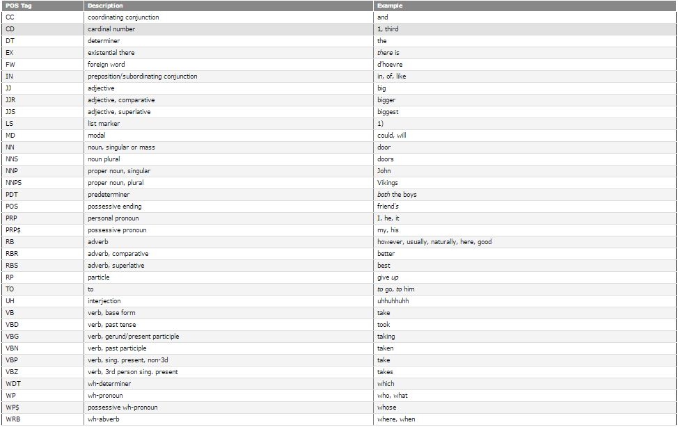

Slide 12
ANALYSIS OF PARTS OF SPEECH
PARTS OF SPEECH TO BE CONSIDERED | PARTS OF SPEECH NOT TO BE CONSIDERED
Adjectives-(superlative, comparative) | Cardinal Numbers
Adverbs-(superlative, comparative) | Determiners
Verbs (root verbs) | Foreign Words
Personal/Possessive Pronouns | Preposition
Particles (eg: give up, broke down) | List marker
Interjections (Alas, Hooray) | Modal
Punctuations | Pre-determiner
Conjunctions | Proper Nouns
Nouns | Stop Words

Slide 13
IMPLEMENTATION
POS Tagging
Stop words elimination (without eliminating conjunctions)
Lemmatization
Data set expansion using word2vec
Separate heuristics for:
Conjunctions
Punctuators
Particles secondary
Interjections indicators
Personal/Possessive Pronouns

Slide 14
IMPLEMENTATION
Assigning Weights (based on analysis)
Verbs, Adjectives, Adverbs
Secondary indicators
Nouns
Calculating the percentage contribution to every emotion by summing up the scores of each word.
If a particular word is found not to be present in our extended dataset then we feed that word into word2vec and get the words which are semantically closest and assign emotional weights to them.
Since it was a rule-based approach, it is not scalable.

Slide 15
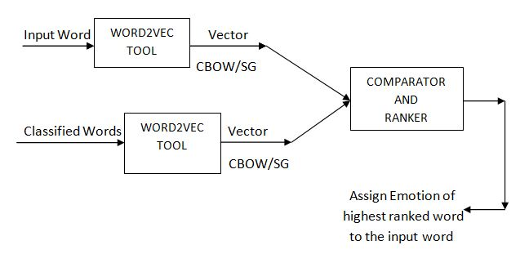
EXPERIMENTATION

Slide 16
Results
EMOTION | % DATASET 1 | % DATASET 2
Joy | 80.49 | 69.64
Anger | 24.11 | 23.01
Disgust | 18.41 | 22.20
Sadness | 23.40 | 23.21
Fear | 28.11 | 36.26
Surprise | 14.44 | 17.73
After POS (SET2)
59.87
32.55
19.20
30.98
33.64
24.52

Slide 17
APPROACH 4
Initial Approach:
We considered 500,000 words and got their vector representation.
We implemented k-means clustering algorithm on them to obtain different clusters of all these words.
We converted the 217,000 phrase dataset into vector representations by constructing a histogram over the clusters of each word in the sentence.
We used the vectors to train them on an SVM multi-class classifier.

Slide 18
EMOTION | ACCURACY
JOY | 39%
LOVE | 29%
SADNESS | 25%
ANGER | 40%
SURPRISE | 0.5%
FEAR | 30%

Slide 19
APPROACH
Modified Approach: find out the optimum no of clusters N and C-parameter for SVM
We considered a larger word list from the Google dataset and clustered the vector representation for these words using k-means.
Same procedure was followed for different pairs of N and C

Slide 20
LDA
Generative model that discovers topics within a given document.
In more detail, LDA represents documents as mixtures of topics that spit out words with certain probabilities.

Slide 21
IMPLEMENTATION ISSUES
NLTK library only provides built-in support for the Reuters corpus. Moreover, the input routines it provides can only read corpora in the LDA-C format.
Close to similar probabilities for a particular word under different topics.

